Slide 1
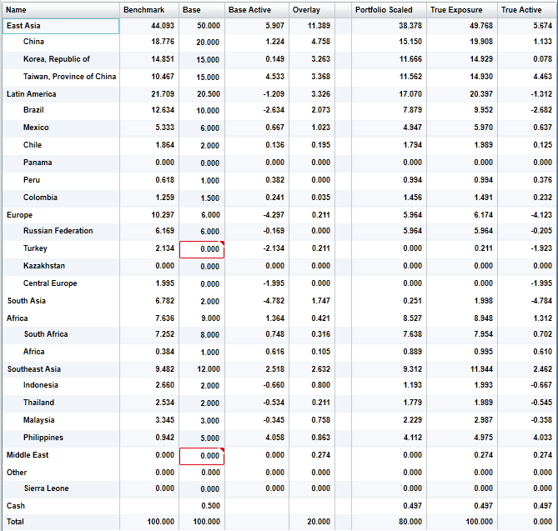
Base – Benchmark
Overlay + Portfolio Scaled
True Exposure – Benchmark
RescaledBase =
Base / (1 - baseWherePortfoioAdjustmentSetTotal) * (1 - porfolioAdjustmentTotal)
Portfolio scaled = (RescaledBase – Overlay) / baseLessOverlayPositiveTotal * baseLessOverlayTotal

